Slide 1
Time Series Forecasting
Session8
Aakash Goel

Slide 2
Introduction to Time Series Analysis
Time series analysis involves studying datasets collected over time to identify patterns and forecast future values.
Common applications in manufacturing include predicting production volumes, energy consumption, and other key metrics.

Slide 3
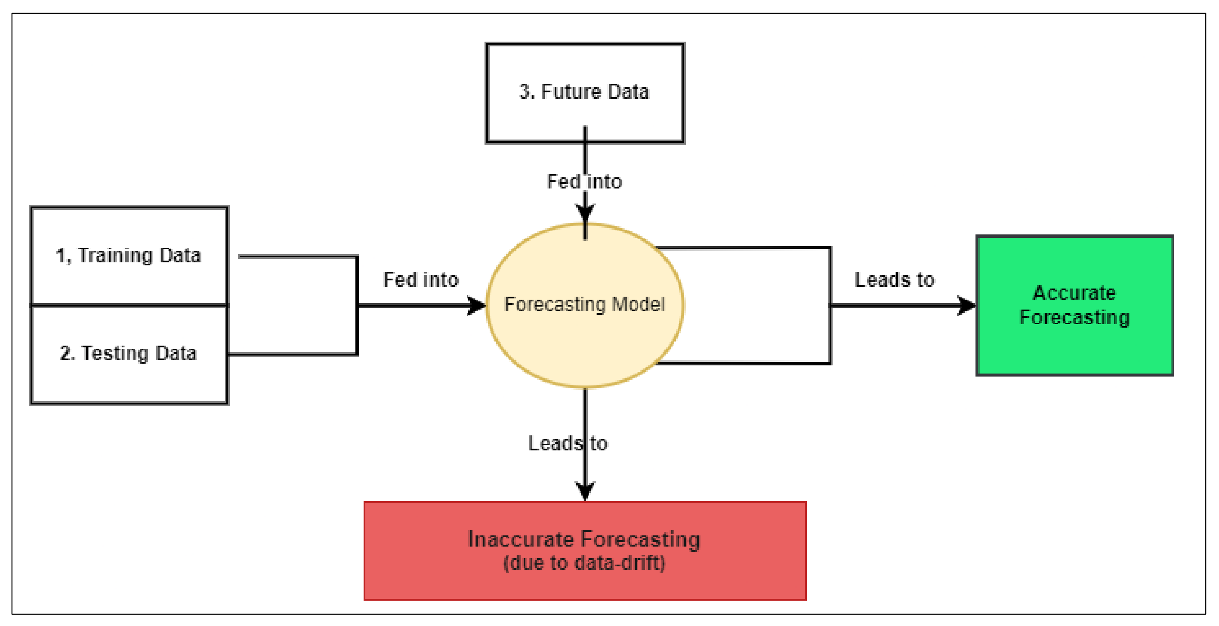

Slide 4
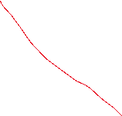

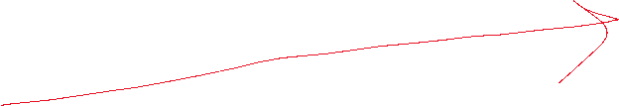




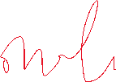
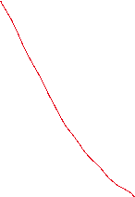





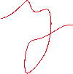





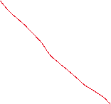

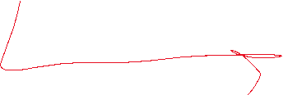

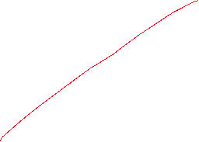
Long term upward or downward movement.
Gradual wear and tear in Machine leading
to higher vibration.
Repeating Patterns at regular intervals.
Cooling systems used more during day shift, less at night.

Slide 5








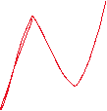

Irregular, unpredictable variation. Sudden spike in energy due to load imbalance..
Time series whose properties like Mean,
Variance don’t changes over time.

Slide 6
Use Cases
Predictive Maintenance – Forecast bearing temperature, If it increase beyond safe range → early action
Demand Forecasting – Predict raw material needed based on past production data
Energy Load Forecasting –
Budget Forecasting

Slide 7
Model | Type | Stationarity Requirement | Seasonality Handling | Handles Non-Linearity | Memory | Computational Complexity | Use Case
LR | Statistical | No | No | No | None | Low | Basic trend forecasting, linear relationships
MA | Statistical | Yes | No | No | Short-term | Low | Forecasting based on past errors
AR | Statistical | Yes | No | No | Short-term (p lags) | Low | Time series with autocorrelation
ARMA | Statistical | Yes | No | No | Short-term (p lags, q errors) | Medium | Stationary time series
ARIMA | Statistical | No (differencing makes it so) | No | No | Short-term (p lags, q errors) | Medium | Non-stationary time series
SARIMA | Statistical | No (differencing makes it so) | Yes | No | Short-term (p lags, q errors) | High | Time series with seasonal components
Prophet | Statistical + Heuristic | No | Yes | Yes (through trend fitting) | Seasonal, yearly, weekly | Medium | Business time series, missing data, holidays
RNN | Deep Learning | No | Yes (if modeled) | Yes | Short to Medium-term | High | Sequential data, time series with long-term dependencies
GRU | Deep Learning | No | Yes (if modeled) | Yes | Short to Medium-term (better than RNN) | High | Sequential data, capturing short and long-term dependencies
LSTM | Deep Learning | No | Yes (if modeled) | Yes | Long-term | Very High | Complex time series with long-term dependencies
IndRNN | Deep Learning | No | Yes (if modeled) | Yes | Long-term (improved over RNN/LSTM) | Very High | Scalable deep learning with better gradient handling

Slide 8
Naïve Forecasting
Assume next value = Last value
Very basic
Sometimes, surprisingly useful !!
Forecast = series[-1]

Slide 9
Moving Average
Average of last N values, smooths out noise..
Say, N= 5
Forecast = sum(series[-N:])/N
Predict tomorrow’s coating thickness using last N day’s average..

Slide 10
Train-Test Split
Unlike normal ML, we can’t shuffle time series data
Always split based on time
Train: Older data (Jan to Sep)
Test: Recent data (Oct.)

Slide 11




Autoregressive Moving Average (ARMA) Model
ARMA combines two components: Autoregressive (AR) and Moving Average (MA).
AR(p): Predicts value based on its previous p values.
MA(q): Predicts value based on previous q errors.

Slide 12




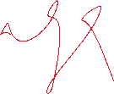


















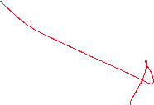





Slide 13




















Slide 14



















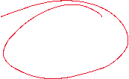

Slide 15

Autoregressive Integrated Moving Average (ARIMA) Model
ARIMA extends ARMA by introducing differencing to handle non-stationary data.
ARIMA(p, d, q): Combines AR, I (integration/differencing), and MA components.

Slide 16






















Slide 17
Seasonal ARIMA (SARIMA) Model
SARIMA adds seasonal components to the ARIMA model.
SARIMA(p, d, q)(P, D, Q, m): Captures both non-seasonal and seasonal patterns.

Slide 18
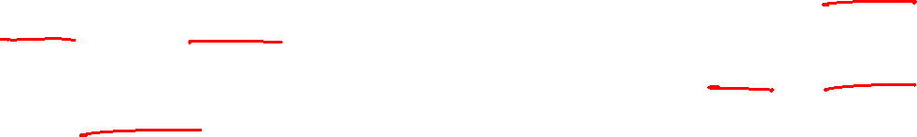
Prophet Model
Prophet is designed to handle time series data with strong seasonal patterns and missing data.
It models time series as an additive combination of trend, seasonality, and holiday effects.

Slide 19
SQL-Based Forecasting
SQL-based forecasting uses historical averages for quick predictions.
Methods include Last Three Months Average, Last Year Same Time Month Average, and Last Year Same Time Three Months Average.

Slide 20
Introduction to Time Series Analysis
A time-series is a set of observations on a quantitative variable collected over time.
Examples
Dow Jones Industrial Averages
Historical data on sales, inventory, customer counts, interest rates, costs, etc
Businesses are often very interested in forecasting time series variables.
Often, independent variables are not available to build a regression model of a time series variable.
In time series analysis, we analyze the past behavior of a variable in order to predict its future behavior.

Slide 21

Methods used in Forecasting
Regression Analysis
Time Series Analysis (TSA)
A statistical technique that uses time-series data for explaining the past or forecasting future events.
The prediction is a function of time (days, months, years, etc.)
No causal variable; examine past behavior of a variable and and attempt to predict future behavior

Slide 22

Components of TSA
Time Frame (How far can we predict?)
short-term (1 - 2 periods)
medium-term (5 - 10 periods)
long-term (12+ periods)
No line of demarcation
Trend
Gradual, long-term movement (up or down) of demand.
Easiest to detect

Slide 23
Components of TSA (Cont.)
Cycle
An up-and-down repetitive movement in demand.
repeats itself over a long period of time
Seasonal Variation
An up-and-down repetitive movement within a trend occurring periodically.
Often weather related but could be daily or weekly occurrence
Random Variations
Erratic movements that are not predictable because they do not follow a pattern

Slide 24
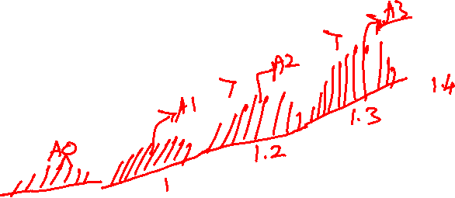
Time Series Plot

Slide 25
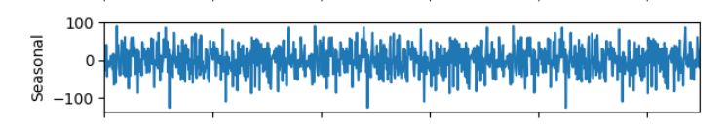


Slide 26
Components of TSA (Cont.)
Difficult to forecast demand because...
There are no causal variables
The components (trend, seasonality, cycles, and random variation) cannot always be easily or accurately identified

Slide 27
Some Time Series Terms
Stationary Data - a time series variable exhibiting no significant upward or downward trend over time.
Nonstationary Data - a time series variable exhibiting a significant upward or downward trend over time.
Seasonal Data - a time series variable exhibiting a repeating patterns at regular intervals over time.

Slide 28

Approaching Time Series Analysis
There are many, many different time series techniques.
It is usually impossible to know which technique will be best for a particular data set.
It is customary to try out several different techniques and select the one that seems to work best.
To be an effective time series modeler, you need to keep several time series techniques in your “tool box.”

Slide 29
Measuring Accuracy
We need a way to compare different time series techniques for a given data set.
Four common techniques are the:
mean absolute deviation,
mean absolute percent error,
the mean square error,
root mean square error.
We will focus on MSE.

Slide 30
Extrapolation Models
Extrapolation models try to account for the past behavior of a time series variable in an effort to predict the future behavior of the variable.

Slide 31
Moving Averages
No general method exists for determining k.
We must try out several k values to see what works best.

Slide 32
Weighted Moving Average
The moving average technique assigns equal weight to all previous observations
The weighted moving average technique allows for different weights to be assigned to previous observations.
We must determine values for k and the w_{i}

Slide 33
Exponential Smoothing
It can be shown that the above equation is equivalent to:

Slide 34
Seasonality
Seasonality is a regular, repeating pattern in time series data.
May be additive or multiplicative in nature...

Slide 35
Stationary Seasonal Effects

Slide 36
Trend Models
Trend is the long-term sweep or general direction of movement in a time series.
We’ll now consider some nonstationary time series techniques that are appropriate for data exhibiting upward or downward trends.

Slide 37
The Linear Trend Model
For example:

Slide 38
The TREND() Function
TREND(Y-range, X-range, X-value for prediction)
where:
Y-range is the spreadsheet range containing the dependent Y variable,
X-range is the spreadsheet range containing the independent X variable(s),
X-value for prediction is a cell (or cells) containing the values for the independent X variable(s) for which we want an estimated value of Y.
Note: The TREND( ) function is dynamically updated whenever any inputs to the function change. However, it does not provide the statistical information provided by the regression tool. It is best two use these two different approaches to doing regression in conjunction with one another.

Slide 39
The Quadratic Trend Model

Slide 40
Combining Forecasts
It is also possible to combine forecasts to create a composite forecast.
Suppose we used three different forecasting methods on a given data set.
Denote the predicted value of time period t using each method as follows:
We could create a composite forecast as follows:

Slide 41
Example Calculation for SQL-Based Forecasting
Example for Month 1 of the next year:
Last Three Months Average: 513.33 units
Last Year Same Time Month Average: 500 units
Last Year Same Time Three Months Average: 513.33 units
Median Forecast: 513.33 units

Slide 42
Conclusion
Combining time series models (ARMA, ARIMA, SARIMA, Prophet) with SQL-based forecasting provides a robust framework for manufacturing predictions.
Each method has its strengths and is suited to different types of data.

Slide 43
ARMA Model: How It Forecasts
ARMA forecasts by combining Autoregressive (AR) and Moving Average (MA) components.
1. AR Component: Forecasts the next value based on a linear combination of previous values.
2. MA Component: Adjusts the forecast by considering the residual errors from previous predictions.
Equation: X_t = φ1 * X_{t-1} + ... + φp * X_{t-p} + θ1 * ε_{t-1} + ... + θq * ε_{t-q} + ε_t
ARMA models are best suited for stationary time series data.

Slide 44
ARIMA Model: How It Forecasts
ARIMA builds on ARMA by introducing differencing to handle non-stationary data.
1. Differencing Step (I): Transforms the non-stationary time series into a stationary one.
2. AR Component: Forecasts based on differenced series' previous values.
3. MA Component: Adjusts the forecast by considering past errors in the differenced series.
Equation: (1 - φ1 * B - ... - φp * B^p) * (1 - B)^d * X_t = (1 + θ1 * B + ... + θq * B^q) * ε_t
ARIMA is suitable for time series data with trends but no seasonality.

Slide 45
SARIMA Model: How It Forecasts
SARIMA extends ARIMA by adding seasonal components to capture seasonal patterns.
1. Seasonal Differencing: Removes seasonal trends to make the series stationary.
2. Seasonal AR and MA Components: Capture the seasonal patterns in the data.
Equation: (1 - φ1 * B - ... - φp * B^p) * (1 - Φ1 * B^m - ... - ΦP * B^{Pm}) * (1 - B)^d * (1 - B^m)^D * X_t
= (1 + θ1 * B + ... + θq * B^q) * (1 + Θ1 * B^m + ... + ΘQ * B^{Qm}) * ε_t
SARIMA is ideal for data with both trend and seasonal patterns.

Slide 46
Prophet Model: How It Forecasts
Prophet forecasts by decomposing time series into trend, seasonality, and holidays.
1. Trend Component: Models the long-term growth or decline.
2. Seasonality Component: Captures repeating patterns such as daily, weekly, or yearly cycles.
3. Holiday Effects: Adjusts the forecast for specific holidays or events.
Equation: y(t) = g(t) + s(t) + h(t) + ε_t
Prophet is particularly useful for time series data with missing values and non-linear trends.

